Slide 1

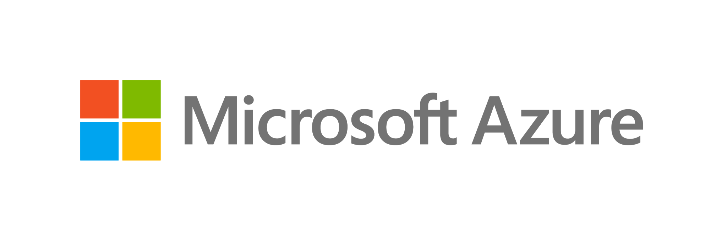
Technology Partner
Bank of Baroda Hackathon - 2022
Your Team Name :
Cairo
Your team bio :
Date :
Ratul Banerjee , web developer
14/10/2022

Slide 2
Problem Statement?
Why did you decide to solve this Problem statement?
Microsoft recommends passwordless authentication methods such as Windows Hello, FIDO2 security keys, and the Microsoft Authenticator app because they provide the most secure sign-in experience.Azure AD Multi-Factor Authentication (MFA) adds additional security over only using a password when a user signs in. The user can be prompted for additional forms of authentication, such as to respond to a push notification, enter a code from a software or hardware token, or respond to an SMS or phone call.
To simplify the user on-boarding experience and register for both MFA and self-service password reset (SSPR). Create a resilient access control management strategy in Azure AD.
Authentication method Security Usability Availability
Windows Hello for Business High High High
Microsoft Authenticator app High High High
FIDO2 security key High High High

Slide 3
User Segment & Pain Points
Which user /advertiser segment would be early adopter of your product & why?
I think bank of baroda is a great site or place as early adopter of my product here in .please see the table below:
Method Primary authentication Secondary authentication
Windows Hello for Business Yes MFA*
Microsoft Authenticator app Yes MFA and SSPR
FIDO2 security key Yes MFA
SMS Yes MFA and SSPR
Voice call No MFA and SSPR
OATH hardware tokens (preview)No MFA and SSPR
OATH software tokens No MFA and SSPR
these authentication methods can be configured in the Azure portal, and increasingly using the Microsoft Graph REST API.

Slide 4
Pre-Requisite
What are the alternatives/competitive products for the problem you are solving?
Microsoft offers the following three passwordless authentication options that integrate with Azure Active Directory (Azure AD): Windows Hello for Business. Microsoft Authenticator app. FIDO2 security keys. Alternative authentication types:
Multi-factor Authentication
Certificate-based Authentication
Biometric Authentication
Token-based Authentication
Single Sign-on

Slide 5
Azure tools or resources
Azure tools or resources which are likely to be used by you for the prototype, if your idea gets selected
Azure AD multi factor authentication : process in which users are prompted during the sign-in process for an additional form of identification, such as a code on their cellphone or a fingerprint scan.Azure AD Multi-Factor Authentication works by requiring two or more of the following authentication methods:
Something you know, typically a password.
Something you have, such as a trusted device that's not easily duplicated, like a phone or hardware key.
Something you are - biometrics like a fingerprint or face scan.
Azure AD Multi-Factor Authentication can also further secure password reset. When users register themselves for Azure AD Multi-Factor Authentication, they can also register for self-service password reset in one step

Slide 6
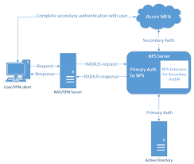
Any Supporting Functional Documents
Present your solution, talk about methodology, architecture & scalability
We can use security defaults in Azure AD tenants to quickly enable Microsoft Authenticator for all users. You can enable Azure AD Multi-Factor Authentication to prompt users and groups for additional verification during sign-in.
For more granular controls, you can use Conditional Access policies to define events or applications that require MFA. These policies can allow regular sign-in when the user is on the corporate network or a registered device but prompt for additional verification factors when the user is remote or on a personal device.

Slide 7
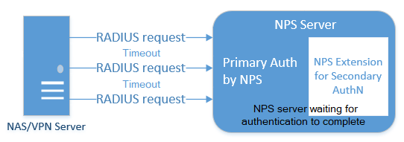
Key Differentiators & Adoption Plan
How is your solution better than alternatives and how do you plan to build adoption?
Integrating existing network policy server infrastructure or NPS with azure AD multi factor authentication. adds cloud-based MFA capabilities to your authentication infrastructure using your existing servers. NPS extension acts as an adapter between RADIUS and cloud-based Azure AD Multi-Factor Authentication to provide a second factor of authentication for federated or synced users.RADIUS protocol behavior and NPS extension :

Slide 8

GitHub Repository Link & supporting diagrams, screenshots, if any
How far it can go?
The following diagram illustrates this high-level authentication request flow:

Slide 9
Thank You
RATUL BANERJEE

